Slide 1
Audit 4 – ITMD 1
Michael-Angelo Yadao, 27415559
Nicholas Cierson, 27318014
Rahul Patel, 27199708
Kostas Zoitakis, 27393741
Muhammad Haseb Ellahi, 27437579
Faraz Yunus, 27489994
Amir Shawwa, 29271627
Team 9, 201718, External 3D Print/Concordia Technology Sandbox, Concordia LB-211

Slide 2
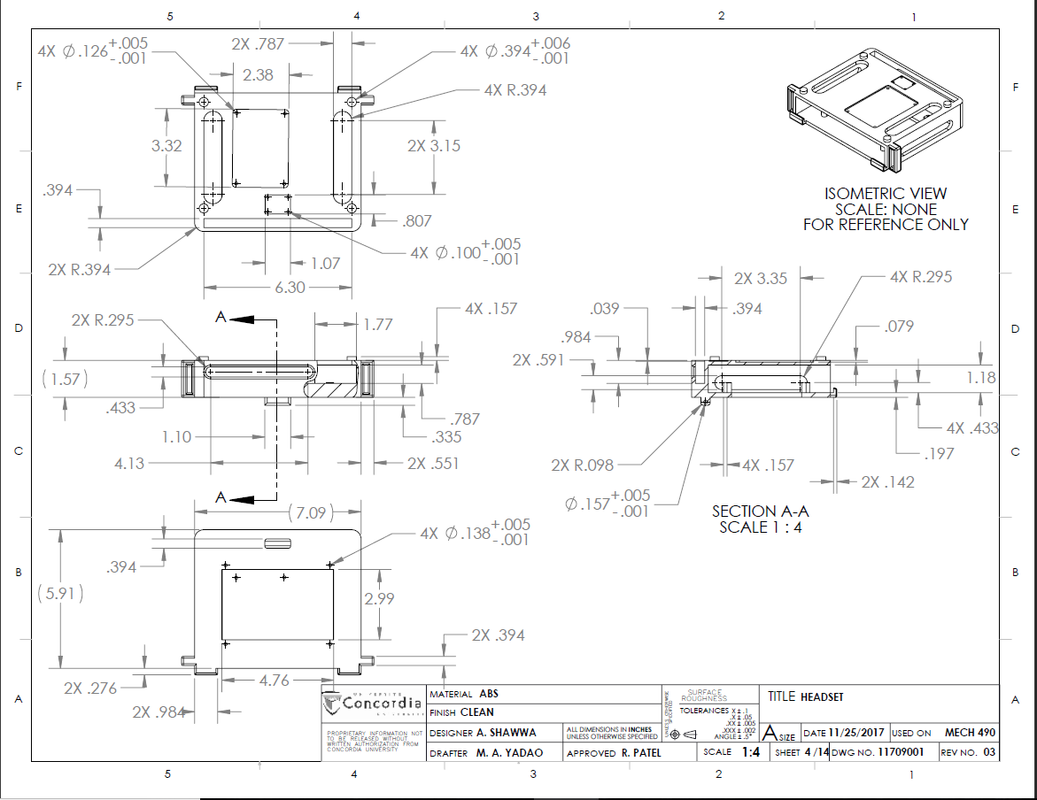
Headset Base
Team 9, 201718, External 3D Print/Concordia Technology Sandbox, Concordia LB-211

Slide 3
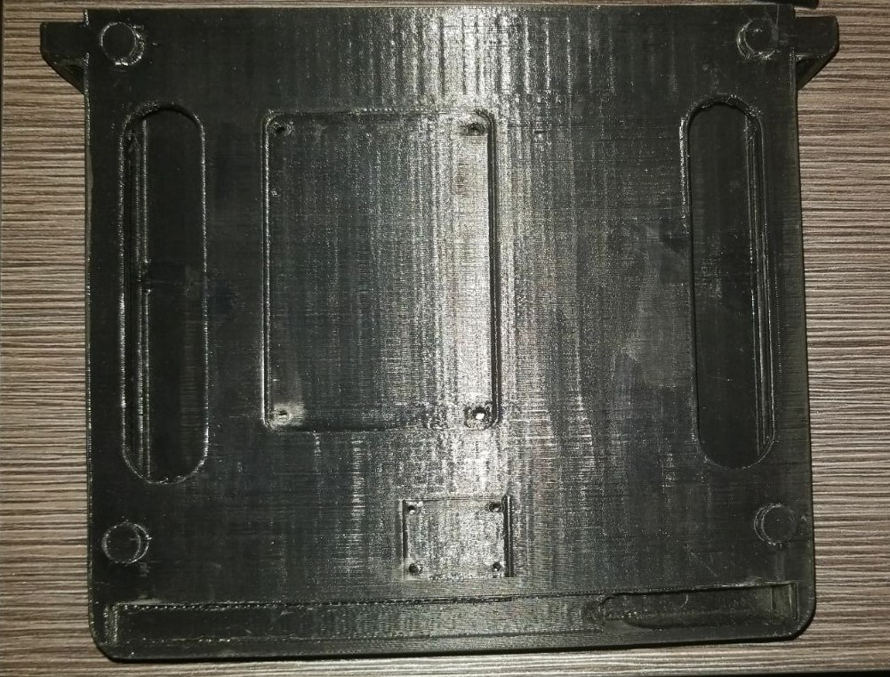
Headset Base
Team 9, 201718, External 3D Print/Concordia Technology Sandbox, Concordia LB-211

Slide 4
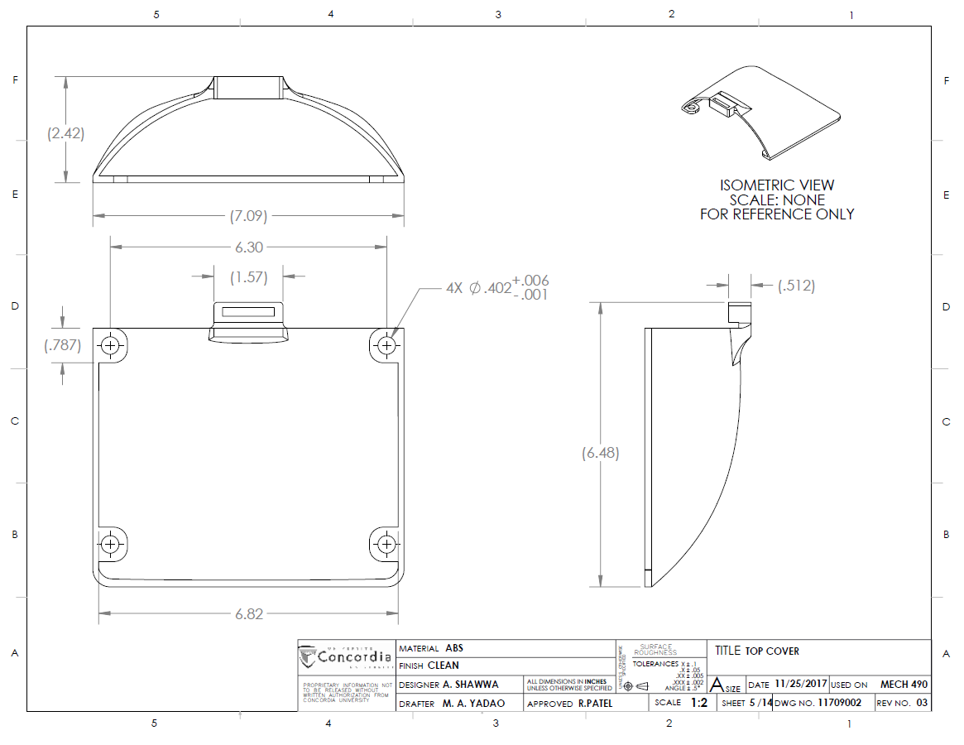
Headset Top Cover
Team 9, 201718, External 3D Print/Concordia Technology Sandbox, Concordia LB-211

Slide 5
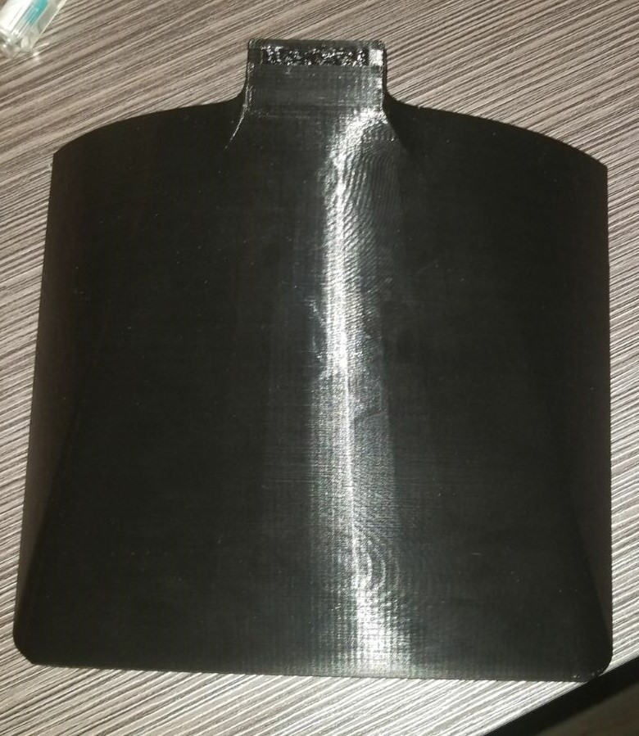
Headset Top Cover
Team 9, 201718, External 3D Print/Concordia Technology Sandbox, Concordia LB-211

Slide 6
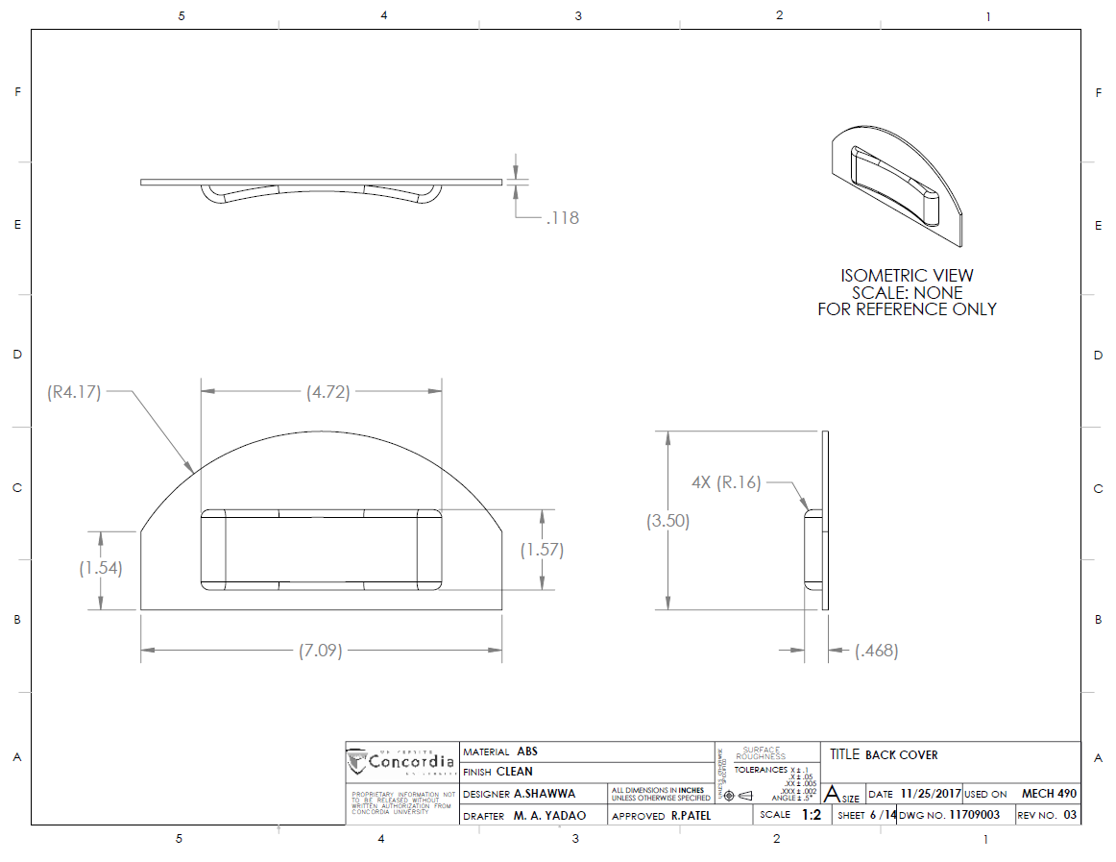
Headset Back Cover
Team 9, 201718, External 3D Print/Concordia Technology Sandbox, Concordia LB-211

Slide 7
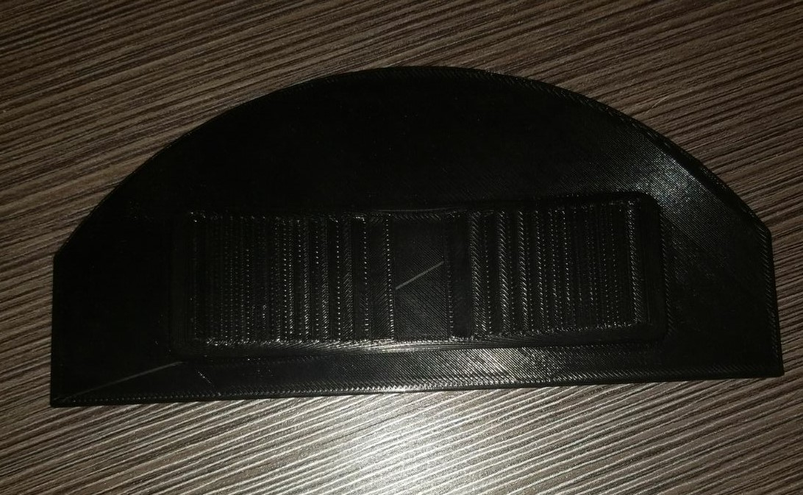
Headset Back Cover
Team 9, 201718, External 3D Print/Concordia Technology Sandbox, Concordia LB-211

Slide 8
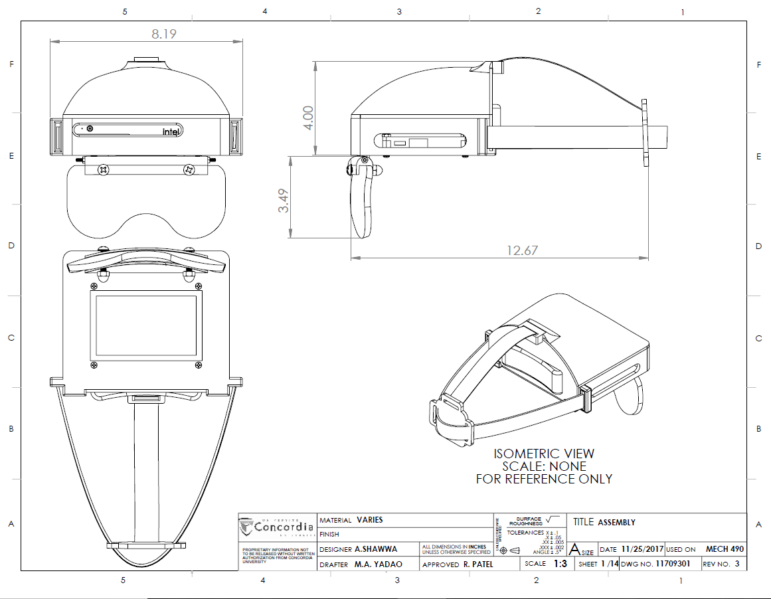
Assembly Drawing
Team 9, 201718, External 3D Print/Concordia Technology Sandbox, Concordia LB-211

